Slide 1
CSC741 Digital Image Processing Project 1
Jessica Gallo & Alex Liew

Slide 2
Assignment
Jessica
A:
Sobel edge detector with threshold = 20, 40, 128. Apply these to various visible and thermal images
Zero-crossing on the following four types of images to get edge images (choose proper thresholds)
Canny edge detector
B:
Frei and Chen gradient operator with threshold = 20
Kirsch compass operator with threshold = 20
Alex:
A:
Robinson compass operator with threshold = 30
Implement and apply a histogram of oriented gradient vector algorithm
Select a suitable edge detector for your application
B:
Nevatia-Babu 5x5 operator with threshold = 30

Slide 3
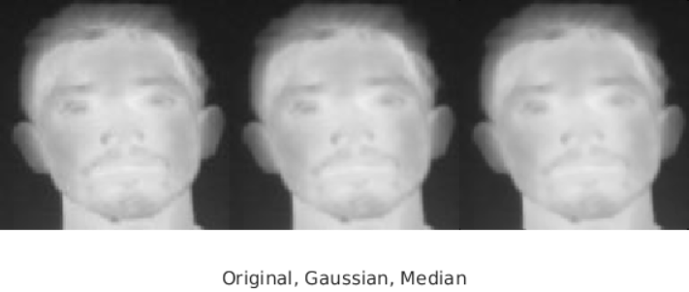
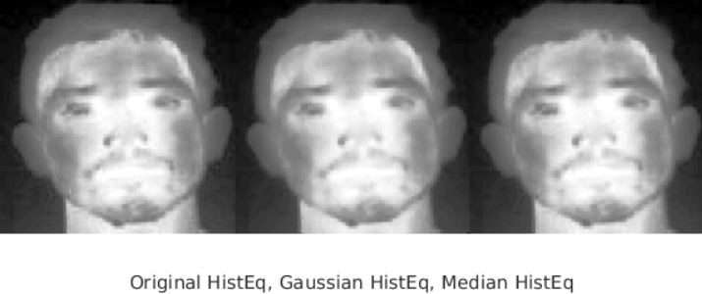
Thermal Images
0.5

Slide 4
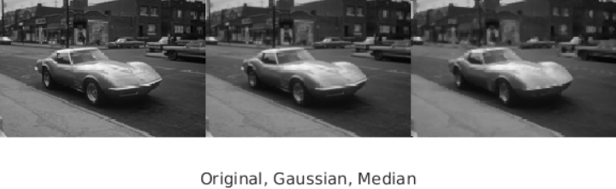
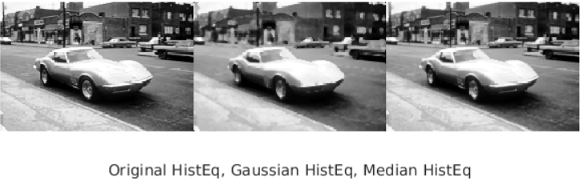
Visual Images
0.5

Slide 5
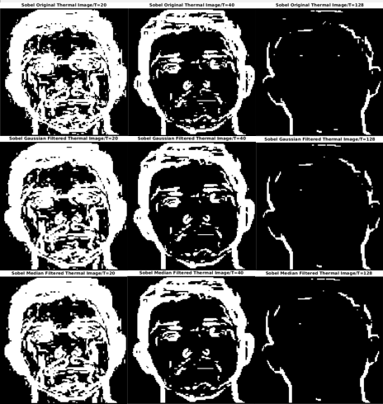
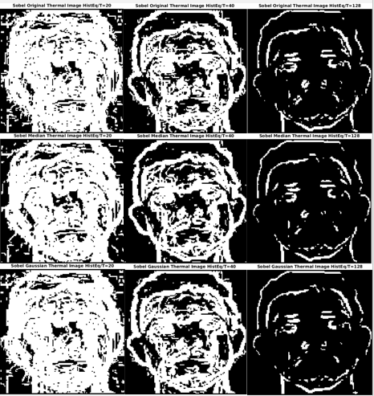
Sobel Thermal Images
T=20
T=40
T=128
T=20
T=40
T=128

Slide 6
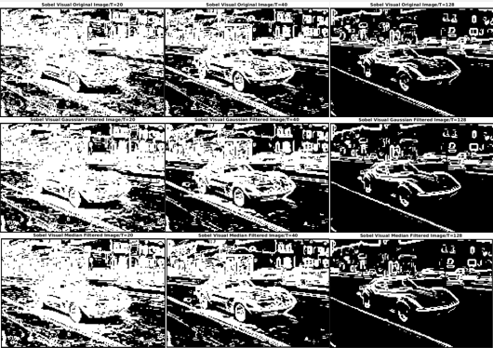
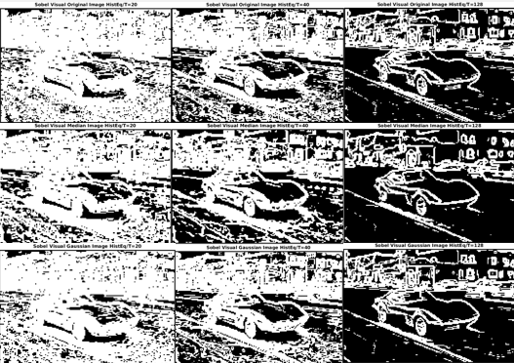
Sobel Visual Images
T=20
T=40
T=128
T=20
T=40
T=128

Slide 7
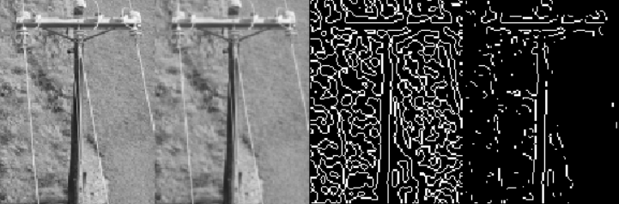
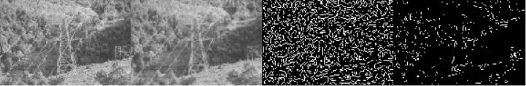
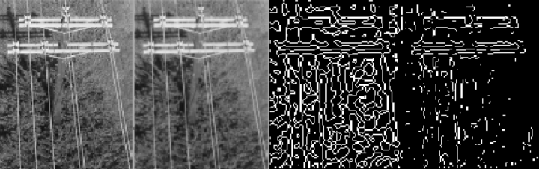
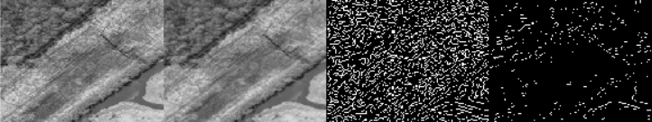
Zero-Crossing Edge Detection
Original
Gaussian
T=0
T=0.01
Original
Gaussian
T=0
T=0.01
Original
Gaussian
T=0
T=0.01
Original
Gaussian
T=0
T=0.01

Slide 8
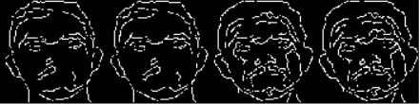
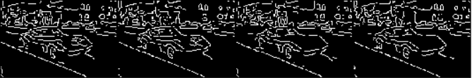
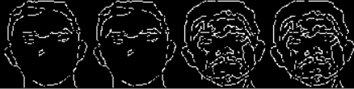
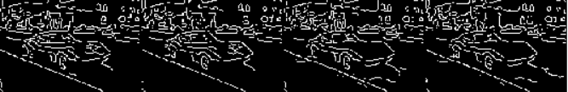
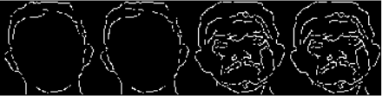
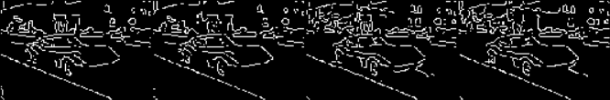
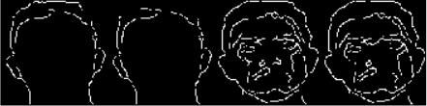
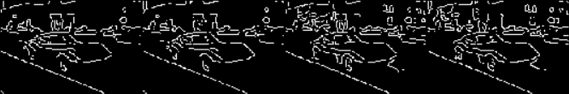
Canny Edge Detection
Original
Gaussian
HistEq
HistEq+Gaussian
Original
Gaussian
HistEq
HistEq+Gaussian
Automatically generated T
0.2
0.3
0.4

Slide 9
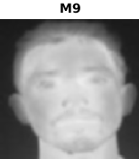
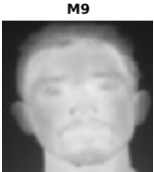
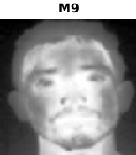

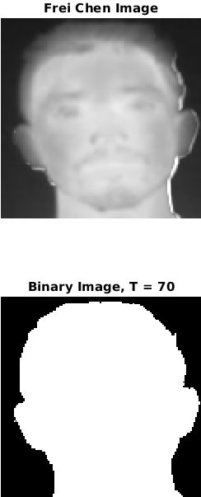
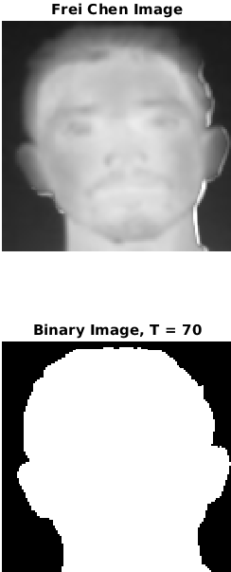
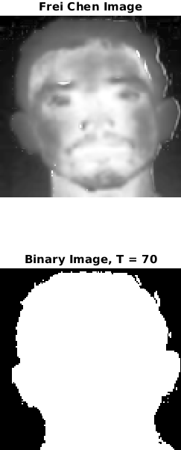
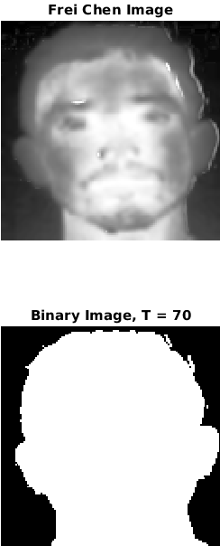
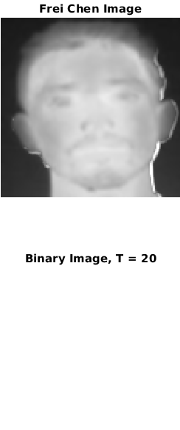
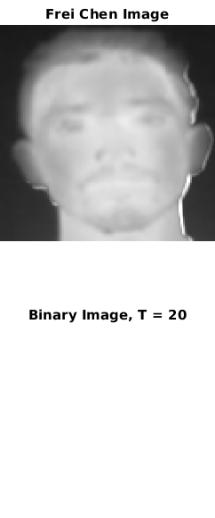
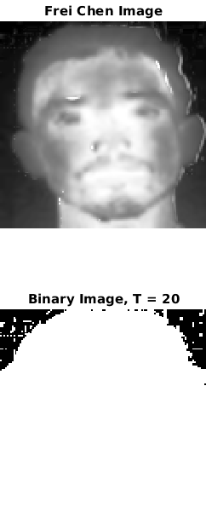
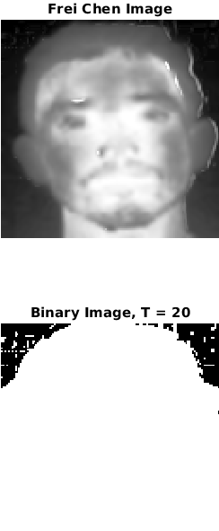
Frei-Chen Gradient Operator
HistEq + Gaussian
HistEq + Gaussian
Original
Gaussian
HistEq
Original
Gaussian
HistEq
T = 70
T = 20

Slide 10
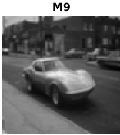

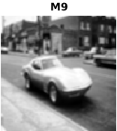
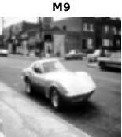
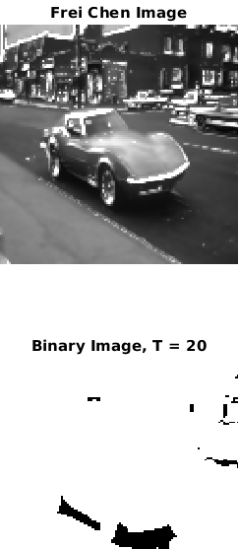
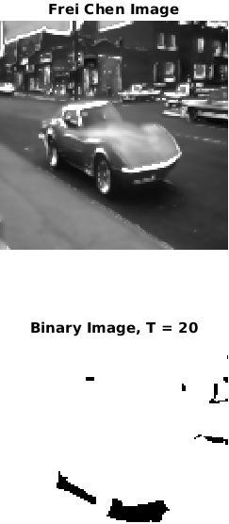
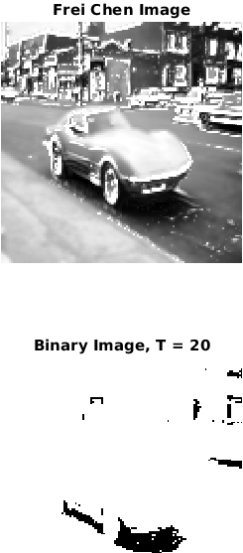
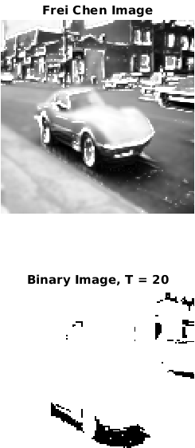
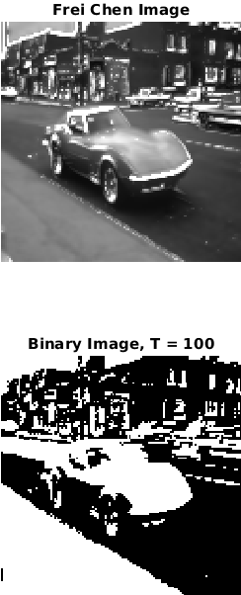
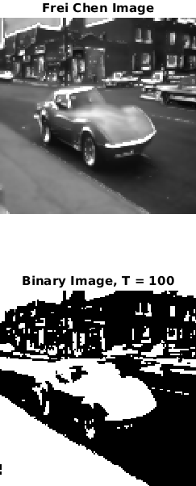
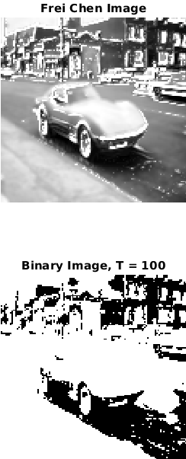
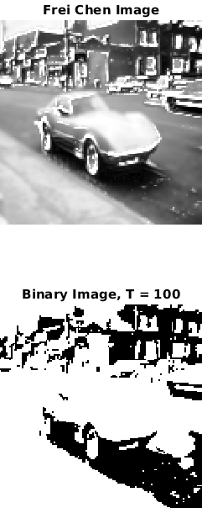
Frei-Chen Gradient Operator
HistEq + Gaussian
HistEq + Gaussian
Original
Gaussian
HistEq
Original
Gaussian
HistEq
T = 20
T = 100

Slide 11
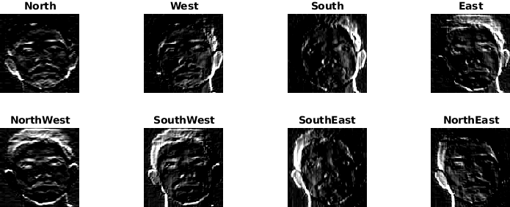
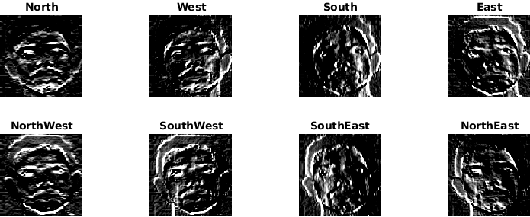
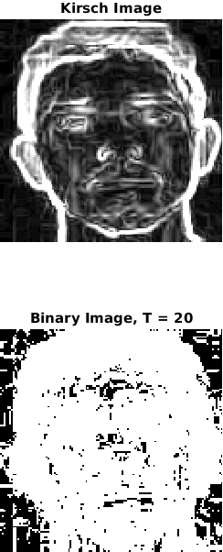
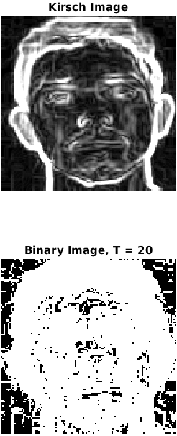
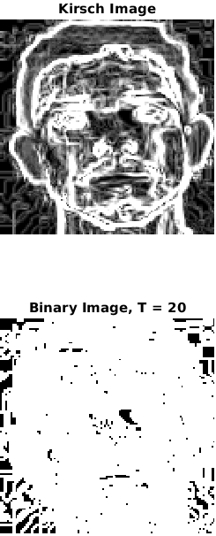
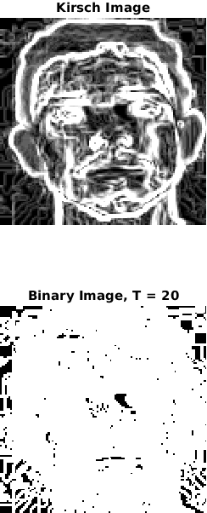
Kirsch Compass operator
Original
Gaussian
HistEq
HistEq + Gaussian

Slide 12
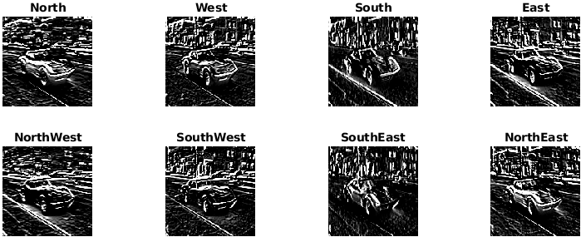
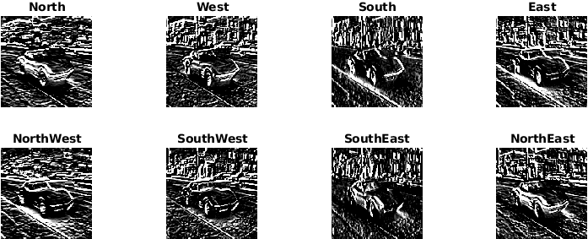




Kirsch Compass operator
Original
Gaussian
HistEq
HistEq + Gaussian

